Slide 1




Night Owl Recipes
Tamara Herrington, Darania Muralitharan, Hajera Rahman & Jordan Smith

Slide 2
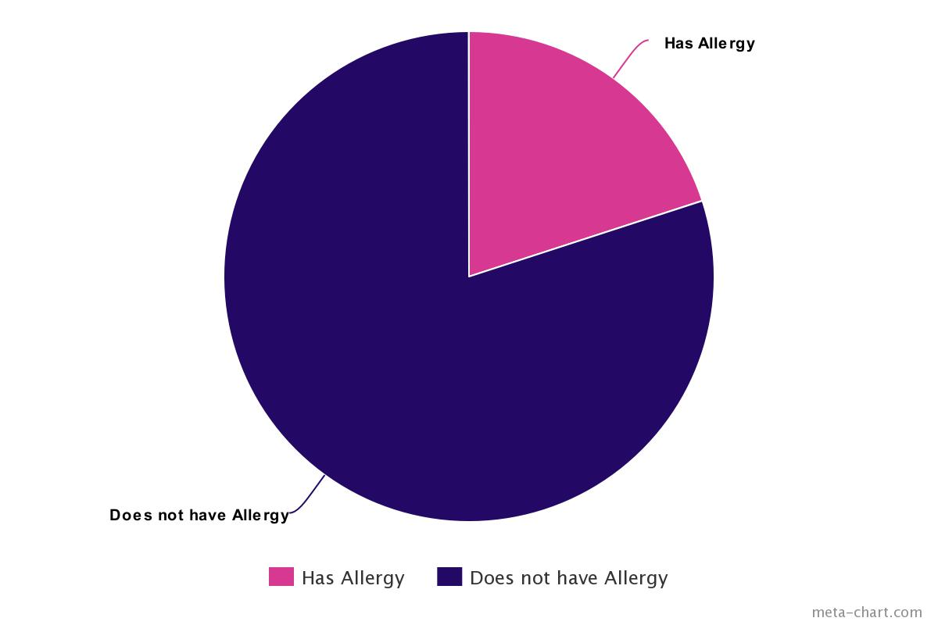
20

Slide 3
Allergy API
An API to search for delicious recipes and filter through depending upon your allergy preference

Slide 4


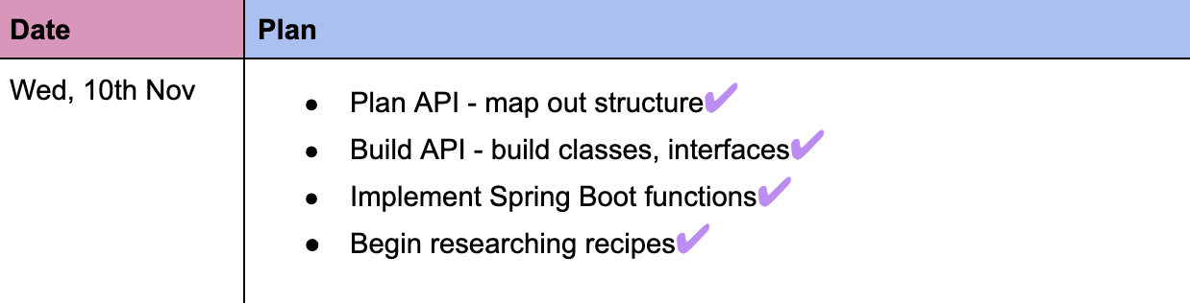

Planning & Organisation
Thorough planning: day by day
Ensuring effective collaboration
Miro: visualising our structure
Record of daily achievements

Slide 5
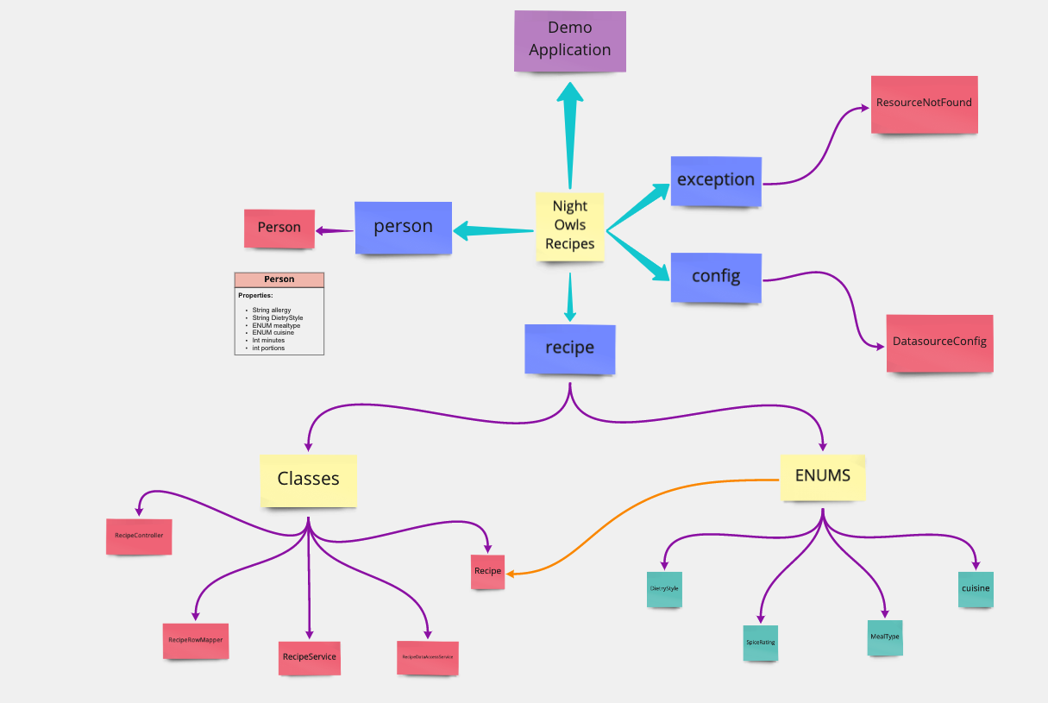


Slide 6
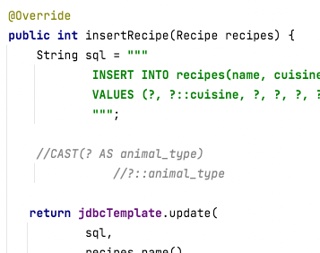
API ENUMS
Created table
Casting + enum type in Data access service
Rowmapper
String
Cuisine.value.of
Enum

Slide 7
Classes and packages structure
Recipe Controller
@GetMapping("{id}")
public Recipe getRecipeId(@PathVariable("id") Integer id) {
return recipeService.getRecipe(id);
}
Recipe Service
public Recipe getRecipe(int id) {
return recipeDAO.selectRecipeById(id)
.orElseThrow(() -> new Exceptions(String.format("Recipe with id %s not found", id)));
}
Recipe Data Access Service
@Override
public Optional<Recipe> selectRecipeById(int id) {
String sql = """
SELECT id, rname, cuisine, vegetarian, vegan, meat_only, pescatarian, meal_type, spice_rating, cooking_time_mins, instructions
FROM recipes
WHERE id = ?
""";
return jdbcTemplate.query(sql, new RecipeRowMapper(), id)
.stream()
.findFirst();
}
Recipes
User
Ingredients
RI (recipes ingredients)
RecipeDAO
Optional<Recipe> selectRecipeById(int id);

Slide 8
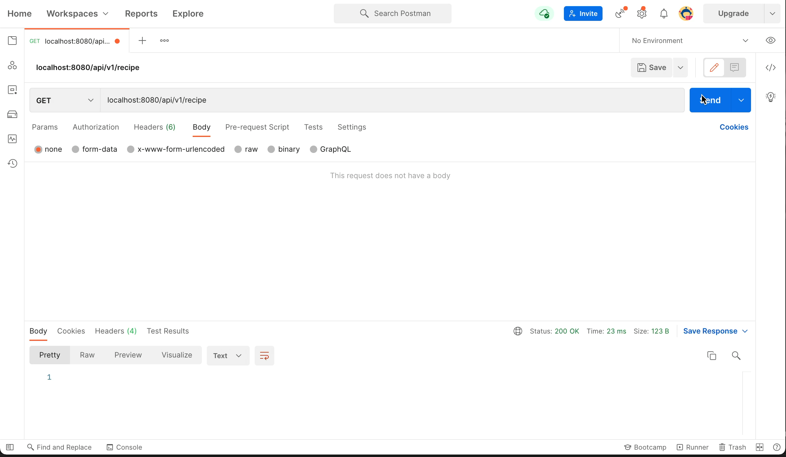
JORDAN & HAJERA RECIPE DEMO - VIDEO 1 SLIDE

Slide 9


Query Making Process
Our Database
Result of Left Join
ID Recipe
ID Ingredient Allergy
R-ID I-ID
1 Pasta
2 Cheese
3 Fish
4 Chips
5 Egg
6 Seasoning
Gluten
Lactose
Fish
Chips
Egg
etc…
1 1
1 2
2 3
2 4
3 5
3 6
Recipe Name
Ingredient Name
1 Pasta
2 Fish & Chips
3 Omelette
Pasta
Pasta
Fish & Chips
Fish & Chips
Omelette
Omelette
Pasta
Cheese
Fish
Chips
Egg
Seasoning
QUERY
SELECT recipes.rname, ingredients.iname
FROM recipes
LEFT JOIN recipes_ingredients
ON recipes_ingredients.recipe_id = recipes.id
LEFT JOIN ingredients
ON recipes_ingredients.ingredient_id = ingredients.id;

Slide 10
Display Ingredients in Array and Remove Allergen
QUERY 2: Add Ingredients to Array
Recipe Name
Array_Agg
SELECT recipes.rname, array_agg FROM recipes
LEFT JOIN (
SELECT recipes_ingredients.recipe_id AS id, array_agg (ingredients.iname)
FROM recipes_ingredients
JOIN ingredients ON recipes_ingredients.ingredient_id = ingredients.id
GROUP BY recipes_ingredients.recipe_id ) ingredients USING (id);
Pasta
Fish & Chips
Omelette
{Pasta, Cheese}
{Fish, Chips}
{Egg, Seasoning}
QUERY 3: Remove Lactose
Recipe Name
Array_Agg
SELECT recipes.rname, array_agg FROM recipes
LEFT JOIN (
SELECT recipes_ingredients.recipe_id AS id, array_agg (ingredients.iname)
FROM recipes_ingredients
WHERE ingredients.allergy_category != 'lactose'
JOIN ingredients ON recipes_ingredients.ingredient_id = ingredients.id
GROUP BY recipes_ingredients.recipe_id ) ingredients USING (id);
Pasta
Fish & Chips
Omelette
{Pasta}
{Fish, Chips}
{Egg, Seasoning}

Slide 11
Common Table Expression (CTE)
QUERY x : Remove Lactose
CTE Query Successful
WITH cte AS (
SELECT id, recipes.rname, iname, allergy FROM recipes
LEFT JOIN (
SELECT recipes_ingredients.recipe_id AS id,
array_agg(ingredients.iname) AS iname,
array_agg(ingredients.allergy_category) AS allergy FROM recipes_ingredients
JOIN ingredients ON recipes_ingredients.ingredient_id =
ingredients.id
GROUP BY recipes_ingredients.recipe_id
) ingredients USING (id)
)
SELECT cte.rname, cte.iname
FROM cte
WHERE NOT cte.allergy @> '{lactose}';
Recipe Name
Array_Agg
Fish & Chips
Omelette
{Fish, Chips}
{Egg, Seasoning}
WHERE NOT cte.allergy @> ‘{?}';

Slide 12
Implementing User Input to psql Query
@GetMapping
public List<RiTwo> listRi(User user, @RequestParam String allergen) {
return riService.getRiTwo(user);
}
”””
SELECT cte.rname, cte.iname
FROM cte
WHERE NOT cte.allergy @> ‘{?}’;
”””
return jdbcTemplate.query(sql, new RiTwoRowMapper());

Slide 13
Final Filter Query
RiDataAccessService:
public List<RiTwo> selectRiTwo(User user) {
String sql = """
WITH cte AS (
SELECT id, recipes.rname, iname, allergy, recipes.cuisine, recipes.vegetarian, recipes.vegan, recipes.meat_only, recipes.pescatarian, recipes.meal_type, recipes.spice_rating, recipes.cooking_time_mins, recipes.instructions
FROM recipes
LEFT JOIN (
SELECT recipes_ingredients.recipe_id AS id, array_agg(ingredients.iname) AS iname, array_agg(ingredients.allergy_category) AS allergy
FROM recipes_ingredients
JOIN ingredients ON recipes_ingredients.ingredient_id = ingredients.id
GROUP BY recipes_ingredients.recipe_id
) ingredients USING (id)
)
SELECT cte.rname, cte.iname, cte.cuisine, cte.vegetarian, cte.vegan, cte.meat_only, cte.pescatarian, cte.meal_type, cte.spice_rating, cte.cooking_time_mins, cte.instructions
FROM cte
WHERE NOT cte.allergy @> string_to_array(?, '');
""";
return jdbcTemplate.query(sql, new RiTwoRowMapper(), user.getAllergy());

Slide 14
Taking An Allergen Input
@GetMapping
public List<RiTwo> listRiTwo(@RequestParam (required = false) String allergen) {
User user = new User();
if (allergen != null) {
user.setAllergy(allergen);
} else {
user.setAllergy("null");
}
return riService.getRiTwo(user);
}
RiController

Slide 15
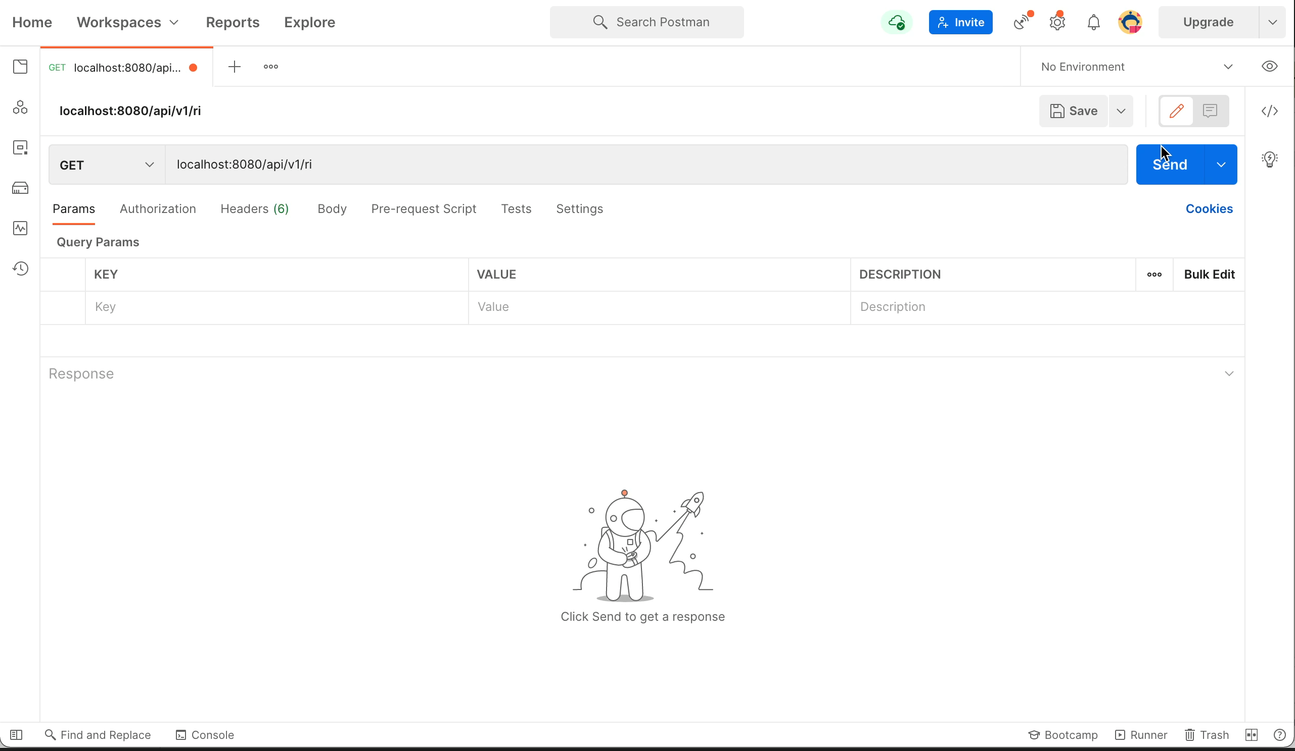
DEMO of FILTER

Slide 16
References
Allergy UK | National Charity. 2021. Allergy UK | National Charity. [online] Available at: <https://www.allergyuk.org> [Accessed 17 November 2021].
nhs.uk. 2021. Allergies. [online] Available at: <https://www.nhs.uk/conditions/allergies/> [Accessed 17 November 2021].
Essential SQL. 2021. Common Table Expressions - The Ultimate Guide. [online] Available at: <https://www.essentialsql.com/introduction-common-table-expressions-ctes/#h-why-do-you-need-sql-cte-s> [Accessed 13 November 2021].
PostgreSQL Documentation. 2021. 9.19. Array Functions and Operators. [online] Available at: <https://www.postgresql.org/docs/current/functions-array.html> [Accessed 14 November 2021].
column, F. and Linoff, G., 2021. Filter rows in PostgreSQL based on values of consecutive rows in one column. [online] Stack Overflow. Available at: <https://stackoverflow.com/questions/43197244/filter-rows-in-postgresql-based-on-values-of-consecutive-rows-in-one-column> [Accessed 14 November 2021].
GitHub. 2021. danvega - Overview. [online] Available at: <https://github.com/danvega> [Accessed 12 November 2021].
GeeksforGeeks. 2021. PostgreSQL - CTE - GeeksforGeeks. [online] Available at: <https://www.geeksforgeeks.org/postgresql-cte/> [Accessed 15 November 2021].
Postgresqltutorial.com. 2021. PostgreSQL CTE. [online] Available at: <https://www.postgresqltutorial.com/postgresql-cte/> [Accessed 16 November 2021].
Techonthenet.com. 2021. SQL: NOT Condition. [online] Available at: <https://www.techonthenet.com/sql/not.php> [Accessed 15 November 2021].
Medium. 2021. SQL — insert values with joined IDs from another table. [online] Available at: <https://towardsdatascience.com/sql-insert-values-with-joined-ids-from-another-table-83ff7f149296> [Accessed 15 November 2021].

Slide 17






Thank You For Listening
Darania Muralitharan
DanaMurali
Hajera Rahman
hajeraR
Jordan Smith
jordan-s99
Tamara Herrington
TamaraHerrington

